Slide 1
Incidence and clinical significance of intrapulmonary shunt in biliary atresia
65th Annual Congress of the Korean Surgical Society
Eun Young Chang, Young Ju Hong, Jung-Tak Oh, Seok Joo Han
Department of Pediatric Surgery, Severance Children’s Hospital, Department of Surgery, Yonsei University College of Medicine, Seoul, Korea

Slide 2
Purpose
Intrapulmonary arteriovenous shunt (IPS) is one of the long-term complications in chronic liver disease.
If arterial oxygen defect in patients with IPS and chronic liver disease is found, hepatopulmonary syndrome (HPS) can be diagnosed
and liver transplantation is sometimes needed for the treatment.
However, it is not well described which characteristics of patients with IPS can be developed to HPS.
Therefore, we investigated the incidence and the clinical significance of IPS in biliary atresia.
Notes:
이후로 지금까지 담도폐쇄 환자에서 저산소증 보이는 환아에서 지속적인 검사가 시행되어 왔으나

Slide 3
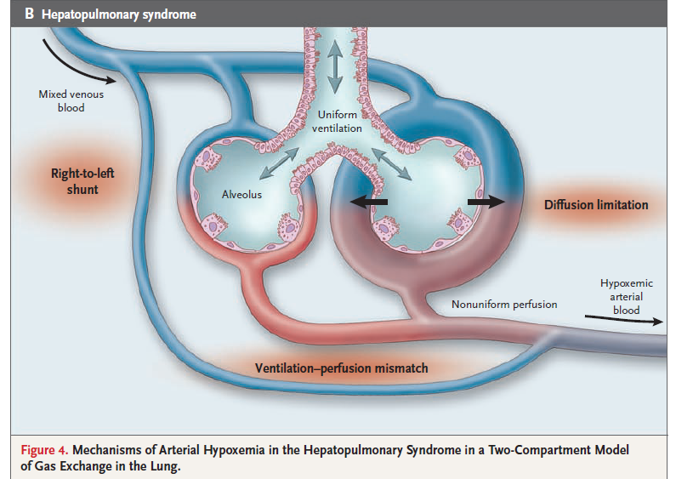
Intrapulmonary shunt
Unknown for pathophysiology,
Vacular dilation caused by Nitric oxide(NO)
Endothelial nitric oxide synthase (eNOS)
Notes:
폐혈관 장애에 의해 발생하게 된다.

Slide 4
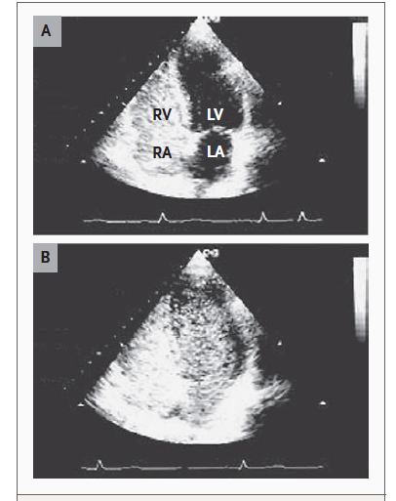
Methods
Study duration: From March 2010 to May 2013.
Patients: Biliary atresia, evaluated for intrapulmonary shunt (IPS)
Diagnosis of IPS: contrast-enhanced echocardiography (CEE).
Agitated normal saline 5cc
Microbubble size: 24-180 μm
Alveolar capillary diameter
: < 8-15 μm
Appearance of microbubble
: < 3-6 cycles
Intrapulmonary shunt
Notes:
동맥혈 내 산소분압이 80mmHg 이상일 때를 경증(mild),
60이상 80mmHg 미만일 때를 중등도(moderate),
50이상 60mmHg 미만일 때를 중증(severe),
50mmHg 미만일 때를 매우 중증(very severe)

Slide 5
Methods
Diagnosis of HPS:
Additional Arterial blood-gas analysis (ABGA):PaO2, AaDO2
Clinical data were reviewed retrospectively
By non-IPS group, IPS without HPS group, and HPS group.
Variable |  | Criterion
Oxygen defect |  | PaO₂* < 80 mmHg or AaDO₂† ≥15 mmHg
Intrapulmonary shunt |  | Positive findings on CEE** within 3-6 heart beats
Liver disease |  | All biliary atresia patients
Degree of severity
 | Mild | AaDO2 ≥15 mmHg, PaO₂ ≥ 80mmHg
 | Moderate | AaDO2 ≥15 mmHg, PaO₂ ≥ 60mmHg to < 80 mmHg
 | Severe | AaDO2 ≥15 mmHg, PaO₂ ≥ 50mmHg to < 60 mmHg
 | Very severe | AaDO2 ≥15 mmHg, PaO₂ < 50 mmHg

Slide 6
Results
Patients :
219 who followed
up for Biliary Atresia
31 negative
for IPS
72 who underwent
evaluation of IPS
(using CEE)
41 positive
for IPS
31
Non-IPS
(Group A)
15
Presence of HPS
(Group C)
20
IPS without HPS
(Group B)
*6 not
examined ABGA

Slide 7
Results
N (total 72) |  | Intrapulmonary Shunt (IPS) |  | N (total 72) | Hepatopulmonary Syndrome (HPS)
31 |  | negative |  | 31 |  | none
41 |  | positive | 56.9% | 20 |  | none
 |  |  |  | 10 |  | Mild | 15 (20.8%)
 |  |  |  | 4 |  | Moderate
 |  |  |  | 1 |  | Severe
 |  |  |  | 0 |  | Very severe
 |  |  |  | 6 |  | Not examined ABGA
Non-IPS
IPS only
HPS

Slide 8
Results
Characteristics |  | Normal (non IPS) (n=31), Group A | IPS without HPS (n=20), Group B | HPS (n=15), Group C | P-value
Age at Kasai operation (day) |  | 56 (10-178) | 66 (36-132) | 60 (17-87) | 0.072
Age at evaluation of IPS (year) |  | 5.6 (0.3-13.1) | 6.1 (0.4-15.4) | 3.7 (0.5 – 12.4) | 0.504
Sex (male/female, n) |  | 14/17 | 9/11 | 4/11 | 0.429
Jaundice free within 6 months after Kasai operation (n) |  | 27 (87.1%) | 15 (75.0%) | 9 (60.0%) | 0.108
Total Bilirubin at evaluation of IPS (mg/dL) |  | 0.6 (0.2-5.9) | 1.5 (0.4-4.0) | 1.9 (0.6-21.2) | 0.005
Direct Bilirubin at evaluation of IPS (mg/dL) |  | 0.2 (0.1-5.1) | 0.8 (0.1-3.5) | 1.2 (0.3-17.1) | 0.001
Liver stiffness score (kPa) |  | 8.7 (3.1-75.0) | 15.5 (6.1-41.3) | 29.3 (12-75) | < 0.0001
Cholangitis event (n) |  |  |  |  | 0.434
 | None | 9 | 4 | 1
 | ≤ 3 times | 12 | 11 | 5
 | >3 times | 9 | 5 | 7
 | unknown | 1 | 0 | 2
LT after diagnosis of HPS (n) |  | 0 (0) | 1 (5%) | 5 (33.3%) | 0.001

Slide 9
Summary
Total/direct bilirubin level at IPS evaluation was significantly increased by groups.
Liver stiffness score was significantly increased by groups.
The liver transplantation after evaluation of IPS significantly more performed according to groups.

Slide 10
Conclusion
The worse clinical outcomes, such as bilirubin level and liver stiffness score were appeared in HPS group than IPS only group.
The presence of IPS in biliary atresia might be considered as the transient step forward to HPS.
Therefore, the identification of IPS and the close-monitoring of patients with IPS in biliary atresia is the substantial in that favorable outcome by the early liver transplantation.

